Slide 1

International Master of Busniess Administration
2025
TRUMPCOIN
TEAM MEMBERS:
SANDU COSTIN - BOGDAN
RADUCANU MIHAI

Slide 2

01
Overview
02
Social Media Impact
TABLE OF
CONTENTS
TrumpCoin’s impact on the world when Donald Trump got elected as the 47th US President.
Analysis of trends in regards of the memecoin known as TrumpCoin.
03
Market Behavior
04
Cultural & Financial Insights
Significant volatiliy present in the stock market of the coin.
Cultural presence of the TrumpCoin, which shaped investor behaviours.
05
Key Takeaways
06
Conclusion
Important conclusions and main ideas in regards of the TrumpCoin
Some final words and ideas about how the TrumpCoin has affected the market.

Slide 3


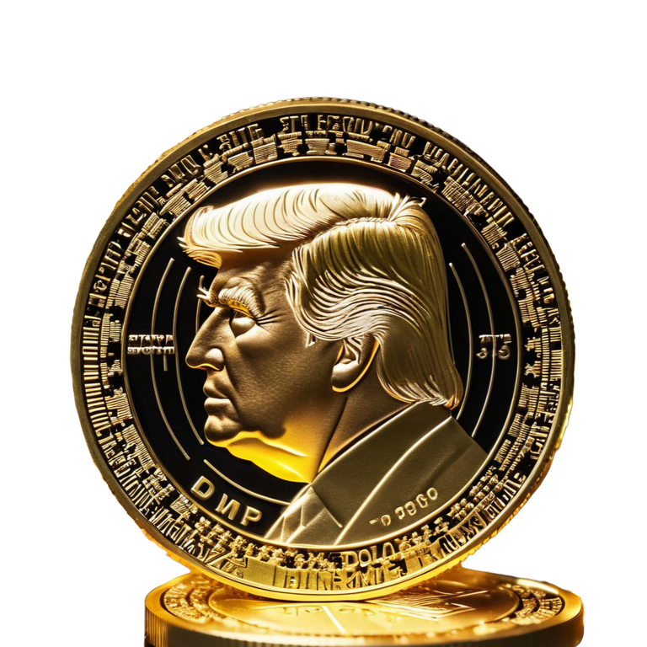
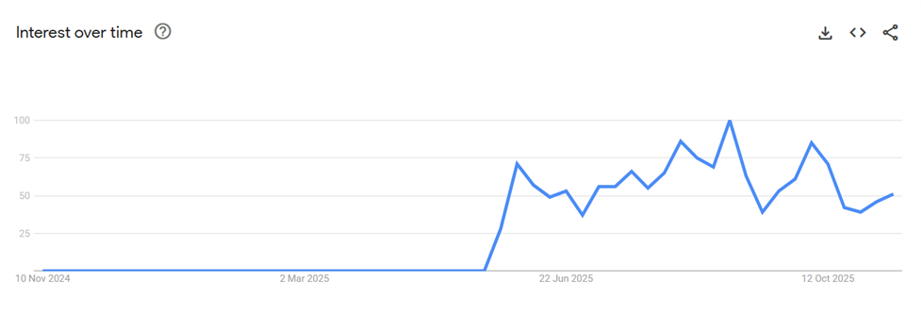
OVERVIEW
The beginning of a new cryptocurrency that took the world by storm.
Launched by Donald J. Trump in January 2025.
A politically branded meme cryptocurrency on Solana.
Combines digital finance, political influence, and viral internet culture.

Slide 4

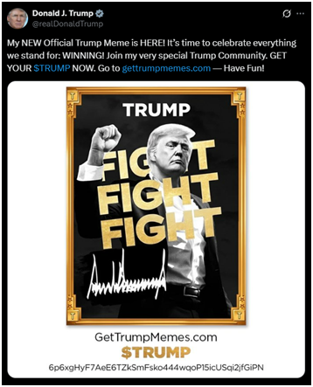
SOCIAL MEDIA IMPACT
Sample of 1000 tweets mentioning TrumpCoin analyzed.
Majority of sampled tweets are positive, showing support and enthusiasm.
Common terms: “winning,” “community,” “invest in $TRUMP.”
Tweet activity spikes after Trump’s posts, showing his influence on engagement.

Slide 5
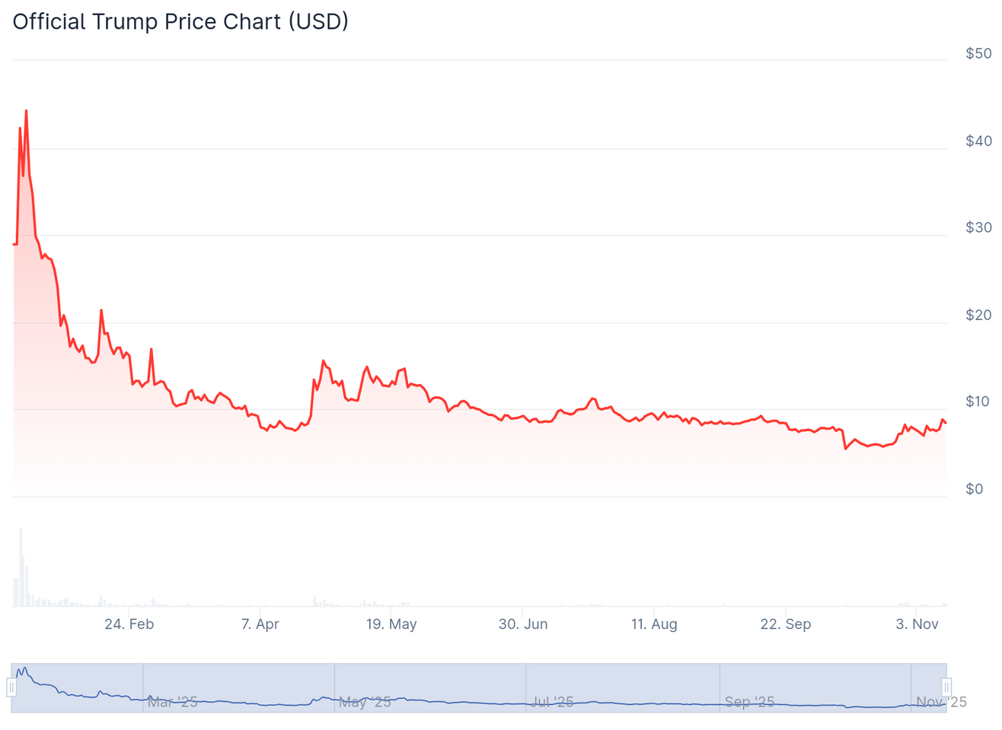
MARKET BEHAVIOR
Fluctuation of the market when the coin has made its appearance
Historical price data shows significant volatility.
Major fluctuations often follow announcements or social media posts.
7-day moving average smooths out short-term fluctuations.
Daily return distribution highlights periods of high market activity.

Slide 6
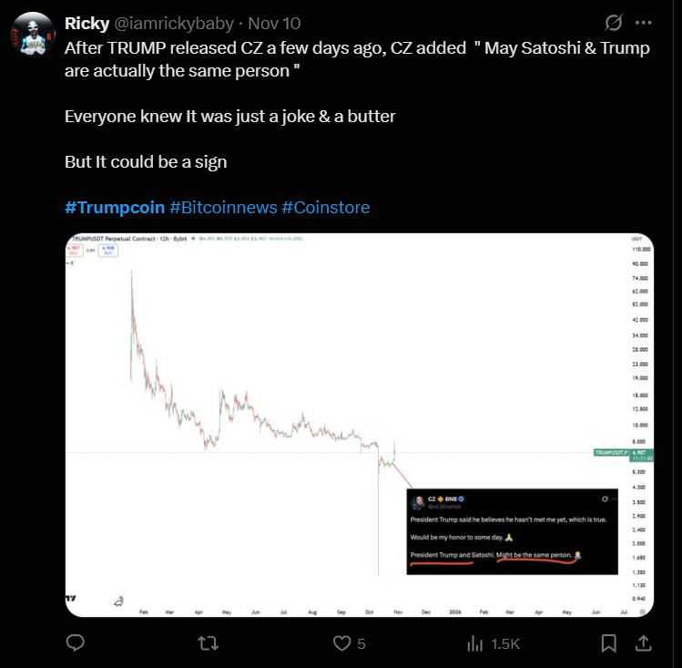
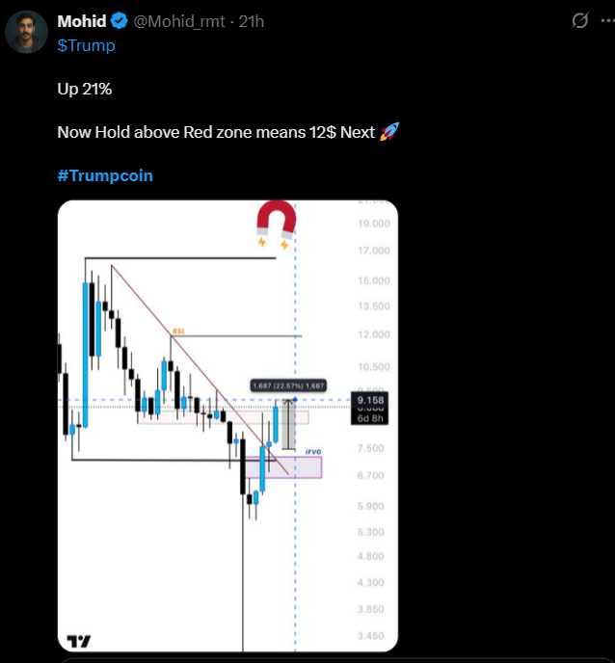
CULTURAL & FINANCIAL INSIGHTS
Meme-driven narratives and political branding influence investor behavior.
Shows how online communities can convert social enthusiasm into market impact.
TrumpCoin acts as both a cultural phenomenon and a financial asset

Slide 7

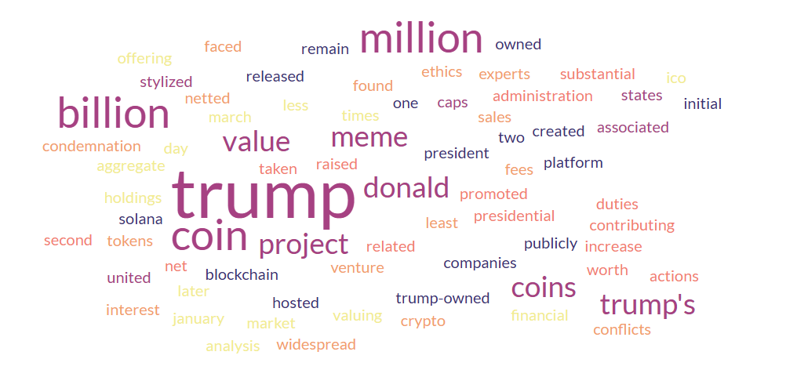
WORDCLOUD

Slide 8
KEY TAKEAWAYS
Social media sentiment strongly impacts coin adoption and price.
Positive sentiment dominates the sample, even when words appear negative in dictionary definitions.
Celebrity influence and political branding are major drivers of market activity.
Raises ethical and regulatory questions for politically associated cryptocurrencies.

Slide 9

CONCLUSIONS
• TrumpCoin’s success is driven by Trump’s personal brand and online influence.
• Social media sentiment strongly shapes market performance and volatility.
• The project blurs lines between politics, finance, and digital culture.
• Highlights both the power and risks of personality-driven cryptocurrencies.

Slide 10
THANK YOU
FOR WATCHING

